Slide 1
System Generation for Time and Activity Management Product Lines
presented by Jenya Levin
Ottawa-Carleton Institute for Computer Science

Slide 2
Overview
Modeling and product lines
Product line derivation
Technologies involved
Case studies
Klok
Leia
Anuko Time Tracker
TimeTrex
Methodology analysis
Future work
Contributions
References

Slide 3
Modeling and Product Lines
Modeling
Stakeholder communication and documentation
Modeling-driven development
Automated processing and code generation
Product Lines
Commonalities and variabilities
Asset re-use and design for re-use
Quality control and regression testing
Documentation and traceability

Slide 4
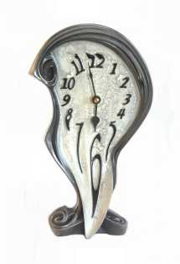
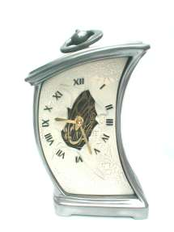
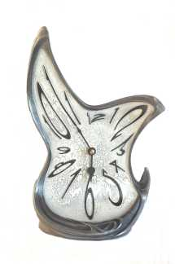
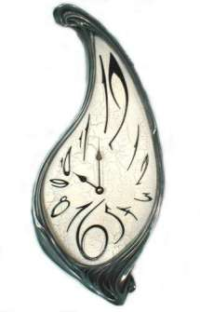
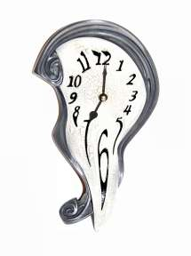
Product Line Derivation
Original systems
System models
Product line
+
Invocation files
Variety of systems in the domain
S1
S’1
VML4Umple
VML
UML
S’2
VML
S2
UML
…
S’n
VML
VML
S’n+1
…
Sn
…
Sm
UML
VML

Slide 5
Technologies involved
ERD – to extract application data structures
UML – class and use case diagrams to model original systems
UMLet – GUI tool for graphical UML modeling that uses XML-based file format
Umple – textual language based on UML allowing for object-oriented code generation
VML – language for modeling variabilities and invoking features to build individual systems
VML4Umple – product line modeling language

Slide 6
Case Studies
Klok
Free, single-user
DB tables: N/A
Classes: 2
Clusters: 2
Leia
Proprietary, multi-user
DB tables: 55
Classes: 54
Clusters: 7
Anuko Time Tracker
Open source, multi-user
DB tables: 16
Classes: 15
Clusters: 6
TimeTrex
Open source, multi-user
DB tables: 99
Classes: 122
Clusters: 17

Slide 7
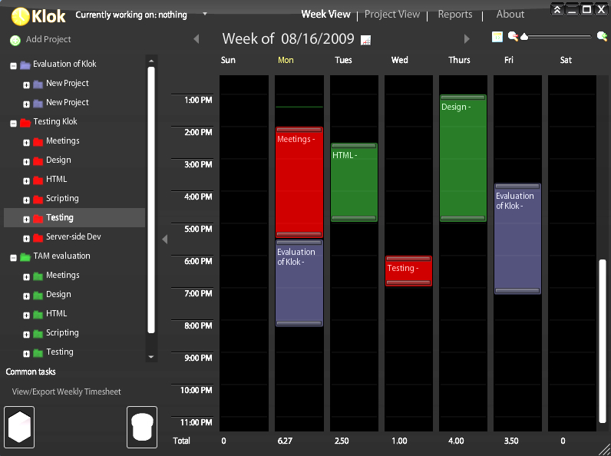
Example – Klok - Screenshot

Slide 8
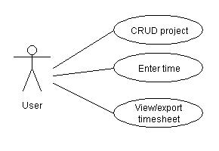
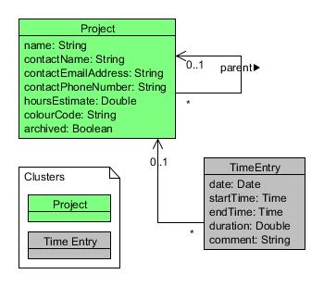
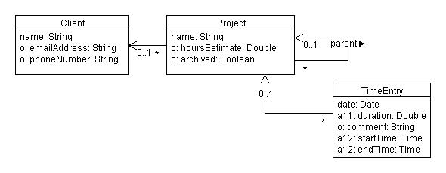
Example – Klok
Use cases
Class diagram
Product line

Slide 9
Example – Klok – Umple code
class Project{
String name;
Double hoursEstimate;
Boolean archived;
}
class TimeEntry{
Date date;
Double duration;
String comment;
Time startTime;
Time endTime;
}
class Client{
String name;
String emailAddress;
String phoneNumber;
}
association {
0..1 Project parent <- * Project;
}
association {
0..1 Project <- * TimeEntry;
}
association {
0..1 Client <- * Project;
}

Slide 10
Example – VML4Umple
Concern CTimeEntry{ // time entry can have a rejection comment
VariationPoint VPTimeEntryRejectedComment{
Kind: Optional;
class TimeEntry{
String rejectedComment;
}
}
// either duration or both start and end time are required
VariationPoint VPEntryDuration{
Kind: Alternative;
Variant VDuration{
class TimeEntry{
Double duration;
}
}
Variant VStartEndTime{
class TimeEntry{
Time startTime;
Time endTime;
}
}
}
}

Slide 11
Example – Klok – Invocation file
// Invocation of a system similar to Klok
// Time Entry
// log time start and end times
invoke(CTimeEntry, VPEntryDuration, VStartEndTime);
// Project
// enter time against projects (client-related work items)
invoke(CTimeEntryAgainstProject, VPEntryAgainstProject, VProject);
// store optional comments for time entries
invoke(CTimeEntryAgainstProject, VPTimeEntryComment);
// allow projects to have parent projects
invoke(CTimeEntryAgainstProject, VPProjectParent);
// store project time estimates
invoke(CTimeEntryAgainstProject, VPProjectEstimate);
// allow archiving projects
invoke(CTimeEntryAgainstProject, VPProjectArchive);
// associate projects with clients
invoke(CTimeEntryAgainstProject, VPClient);
// store client email
invoke(CTimeEntryAgainstProject, VPClientEmail);
// store client phone number
invoke(CTimeEntryAgainstProject, VPClientPhoneNumber);
alternative variation points
optional variation
points

Slide 12
Example – Klok – Original vs invoked
// Umple code for original system
class Project{
String name;
Double hoursEstimate;
Boolean archived;
}
class TimeEntry{
Date date;
Double duration;
String comment;
Time startTime;
Time endTime;
}
class Client{
String name;
String emailAddress;
String phoneNumber;
}
association {
0..1 Project parent <- * Project;
}
association {
0..1 Project <- * TimeEntry;
}
association {
0..1 Client <- * Project;
}
// Umple code for the system based on Klok
class TimeEntry{ Date date; }
class TimeEntry{
Time startTime;
Time endTime;
}
class Project{ String name; }
association {
0..1 Project <- * TimeEntry;
}
class TimeEntry{ String comment; }
association {
0..1 Project parent <- * Project;
}
class Project{ Double timeEstimate; }
class Project{ Boolean archived; }
class Client{ String name; }
association {
0..1 Client <- * Project;
}
class Client{ String emailAddress; }
class Client{ String phoneNumber; }

Slide 13
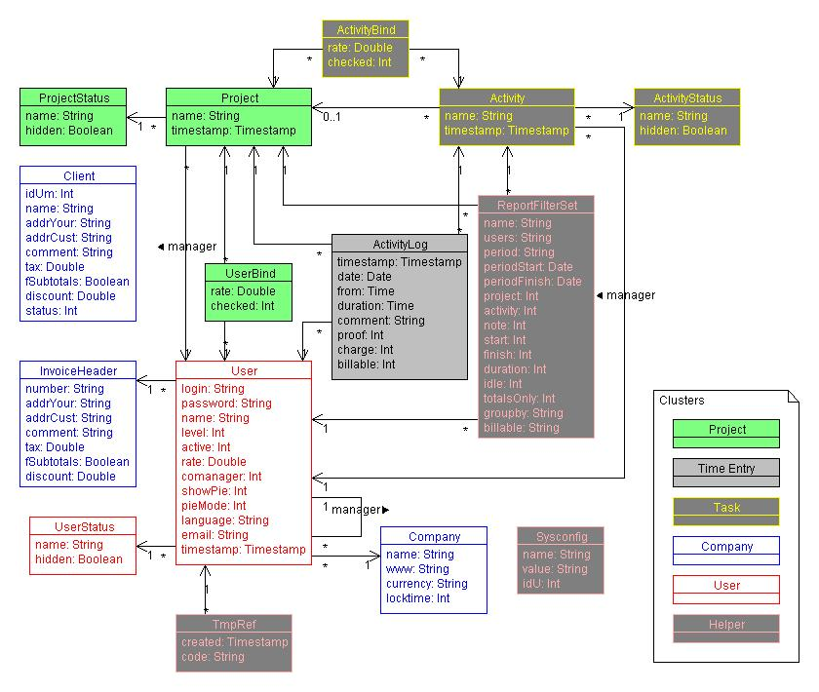

Slide 14
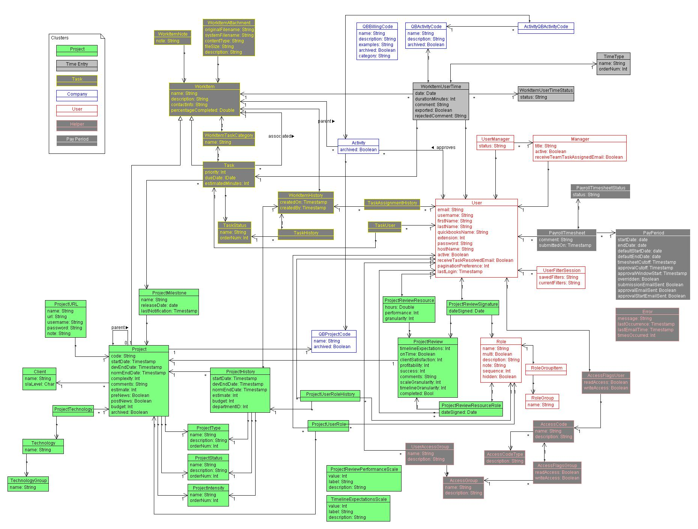

Slide 15
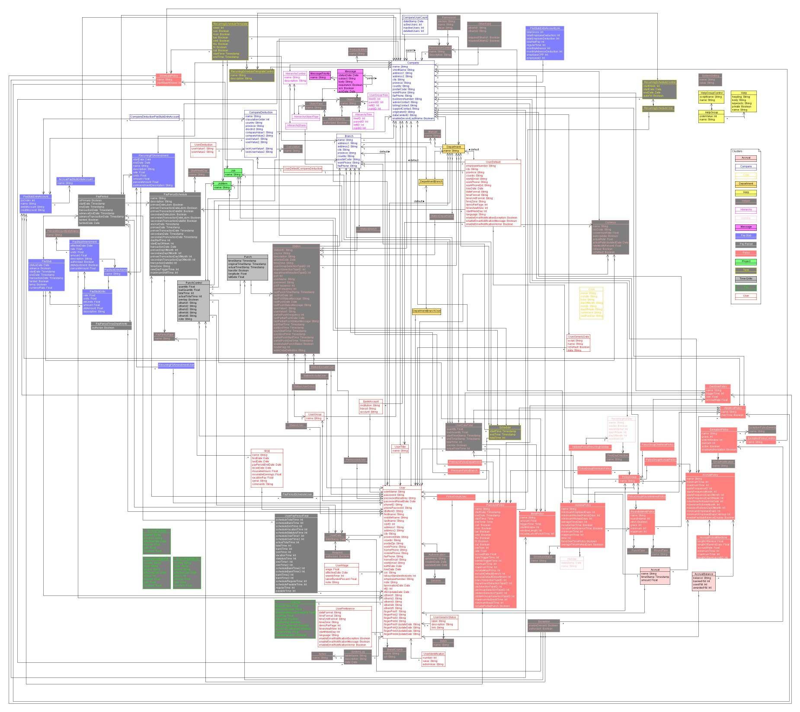

Slide 16
Methodology Analysis
Domain-specific product line derivation:
Analyze and model several existing applications
Iteratively bring the systems to a common base
Build product line from base case up
Process automation
First two steps require human involvement
Mapping similar functionality elements
Annotations for original systems

Slide 17
Future Work
Generate original systems through annotations
Feature selection via dependency tree
GUI-driven invocation file adjustments
GUI-driven system addition to product line
Umple-based UI generation for CRUD functions
Product lines for other domains
Registration systems
Shopping carts and point-of-sale systems
Blogs and forums
Task management and scheduling
Calendars
Budget applications

Slide 18
Contributions
General methodology for product line derivation
Thoroughly documented derivation process
Case study in TAM domain
VML4Umple language
Time and activity product line
Models and generated code
Suggestions on automation
Possible future extensions

Slide 19
References
Auer, M., Tschurtschenthaler, T. and Biffl, S. (2003, A flyweight UML modelling tool for software development in heterogeneous environments. Euromicro Conference, 2003. Proceedings. 29th, pp. 267-272, 2003.
Forward, A., Lethbridge, T. C. and Brestovansky, D. Improving program comprehension by enhancing program constructs: An analysis of the Umple language, in 2009, pp. 311-312.
Loughran, N., Sánchez, P., Garcia, A. and Fuentes, L. (2008, Software Composition, pp. 36-51, 2008.
System Generation for Time and Activity Management Product Lines - Support materials, accessed 2009, http://www.site.uottawa.ca/~tcl/gradtheses/jlevin/
Software Architecture: Foundations, Theory, and Practice. Wiley Publishing, 2009, pp. 750.
VML Online, accessed 2009, http://cruise.site.uottawa.ca/umpleonline/vml.html

Slide 20
References
Sánchez, P., Loughran, N., Fuentes, L. and Garcia, A., "Engineering languages for specifying product-derivation processes in software product lines," in Software Language Engineering: First International Conference, SLE 2008, Toulouse, France, September 29-30, 2008. Revised Selected Papers Anonymous Springer-Verlag, 2009, pp. 188-207.
Klok, accessed 2009, http://klok.mcgraphix.com/
Lixar I.T. Inc., accessed 2009, http://www.lixar.com/
Anuko TimeTracker, accessed 2009, http://www.anuko.com/content/time_tracker/
TimeTrex, accessed 2009, http://www.timetrex.com/
Illustration References
Salvador Dalí, La persistencia de la memoria, 1931
John Tenniel , White Rabbit, 1866, illustration to Alice’s Adventures in Wonderland by Lewis Carroll, 1865
Arabesque gifts, Dalí-style melting clocks, http://www.arabesque-gifts.co.uk/, 2009

Slide 21
Thank you
Questions?

